Slide 1
Risk, security and the law
What could go wrong, and what rules should my company set?
Applied AI and Automation | Session 9 of 12
KLAi Professional Learning | Jotham Martin Wambi
Notes:
Welcome to Session 9. For eight sessions you have built and tested things. Today we ask what could go wrong and what rules your company should set. Start with your question from last time: if this automation made a mistake tomorrow, who would be hurt first?
Keep that answer in mind, because it is the first risk you score today. You leave with a risk register for your own task and a first draft of your AI-use policy.

Slide 2



Today in one view: what you will leave with
By the end of today you will have
A risk register for your own task: each risk scored for likelihood and impact, with an owner and a control
A first draft of your company AI-use policy: approved tools, data rules, human review, disclosure, incidents and training
A plain view of the rules that apply to you in Uganda, and the names of the frameworks you will hear
Notes:
Here is what you leave with. A risk register for your own task, with every risk scored, owned and matched to a control. A first draft of your company AI-use policy, built from the template. And a plain view of the rules that apply in Uganda, with the names of the frameworks you will hear in meetings.
The legal part is short, and I will say clearly where you need your lawyer.

Slide 3
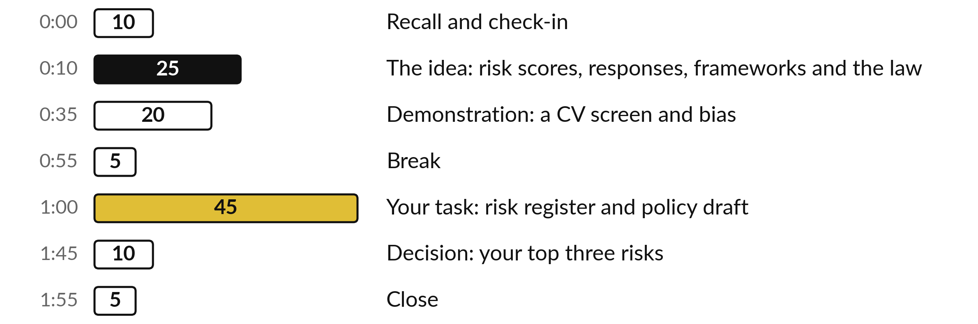
Your two hours: 45 minutes are your own work
45 of the 120 minutes are yours: a register and a policy draft for your own company.
Notes:
The session has three big parts. Twenty-five minutes of ideas: risk scores, the four responses, the frameworks and the law. Twenty minutes on a live demonstration of how bias can enter a CV screen. After the break, forty-five minutes are yours: the register first, then the policy draft.
The last ten minutes are for your decision on your top three risks.

Slide 4

Three questions from last time
1. Where does the secret key live, and why?
2. Which two numbers go in your result line?
3. Name two limits to know before you run a script.
Answer aloud first. Then we check together.
Notes:
Three quick questions from Session 8. Answer aloud first, and then we check together. It is a warm-up to bring last time back.
Question one. Where does the secret key live, and why? Take a moment.
A good answer is this. In Script Properties. A key in the code is a password on the wall: copies and screenshots carry it.
Question two. Which two numbers go in your result line? Say it to yourself first.
A good answer is this. Minutes saved per run and errors found, both taken from the test log.
Question three. Name two limits to know before you run a script. Think about your own task as you answer.
A good answer is this. Gmail recipients a day (100 consumer, 1,500 Workspace); 6 minutes per run; a free Gemini key takes fake or sample data only.
If an answer was missing, your own task card or last workbook page has it. Now to today.

Slide 5




Words we use today
Word | What it means
Risk register | A table of what could go wrong, how likely, how bad, who owns it and what you do about it.
Score | Likelihood from 1 to 5 times impact from 1 to 5. High is 15 or more, Medium is 8 to 14, Low is below 8.
Control | A real action that lowers a risk, such as a named reviewer or a spending limit.
Personal data | Any information that identifies a living person, such as a name with a phone number.
Shadow AI | Staff using AI tools through personal accounts, outside any company rule.
Notes:
Five words for today. I give the plain meaning of each, and we use every one of them before the end of the session.
Risk register. A table of what could go wrong, how likely, how bad, who owns it and what you do about it.
Score. Likelihood from 1 to 5 times impact from 1 to 5. High is 15 or more, Medium is 8 to 14, Low is below 8.
Control. A real action that lowers a risk, such as a named reviewer or a spending limit.
Personal data. Any information that identifies a living person, such as a name with a phone number.
Shadow AI. Staff using AI tools through personal accounts, outside any company rule.

Slide 6








Eight risks have followed
us through Sessions 1 to 8
Risk | What it looks like at Nile Valley Foods
Wrong answers | An invoice total or a quote is invented.
Data leaving the company | A price list pasted into a free chat tool.
Prompt injection | A supplier email hides an instruction.
Over-broad permissions | An automation can read the whole mailbox.
Cost runaway | A loop calls a paid service all night.
Bias | A CV screen favours some names or places.
Vendor lock-in | Data cannot be moved out of one product.
Key people leaving | Only one person knows how the script works.
Notes:
Here are the risks we have met since Session 1, with one example from Nile Valley Foods for each. Wrong answers. Data leaving the company. Prompt injection, where an incoming email hides an instruction. Permissions that are too wide. Cost runaway from a loop. Bias. Vendor lock-in. And key people leaving with the only knowledge.
You will recognise most of them from your own build. Before we go on, tell me which one worries you most for your own task, and why. Scoring, which comes next, gives you a fair way to compare it with the others.

Slide 7
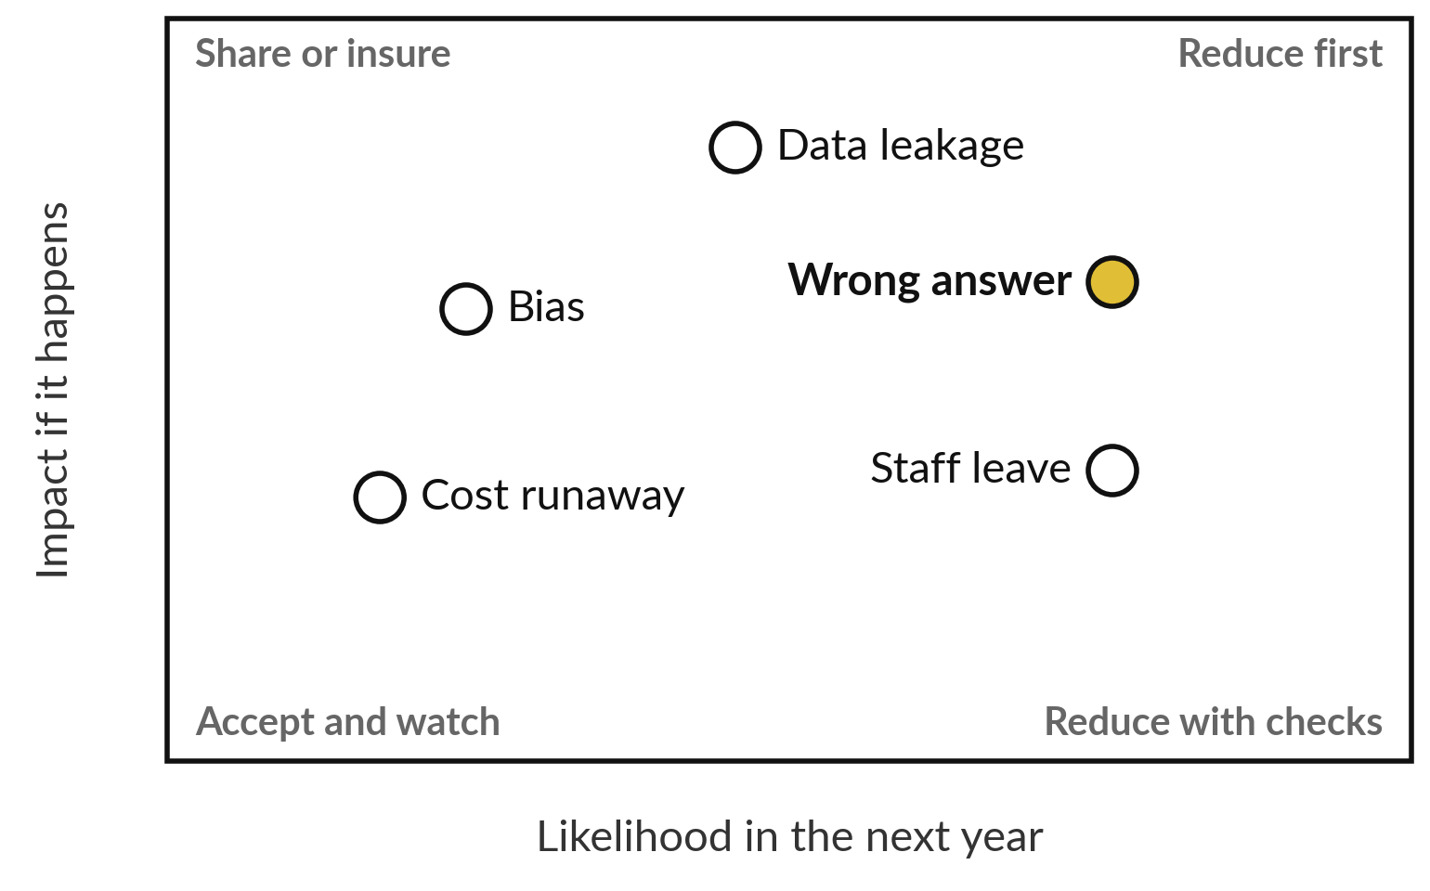
Score every risk as likelihood times impact
Likelihood times impact gives a score from 1 to 25.
High is 15 or more. Medium is 8 to 14. Low is below 8.
High needs a control and a report to the Managing Director.
Positions here are illustrative.
Notes:
This picture sorts risks. Across is how likely a risk is in the next twelve months, from one to five. Up is how bad it would be, from one to five. Multiply the two. The score puts the risk in a band, the same bands as the Scale sheet in your Risk Register.
Fifteen or more is High: it needs a control, and the owner reports it to the Managing Director. Eight to fourteen is Medium: a control and a review date. Below eight is Low: accept it and watch. The positions here are illustrative, and yours will differ because your task is different.

Slide 8
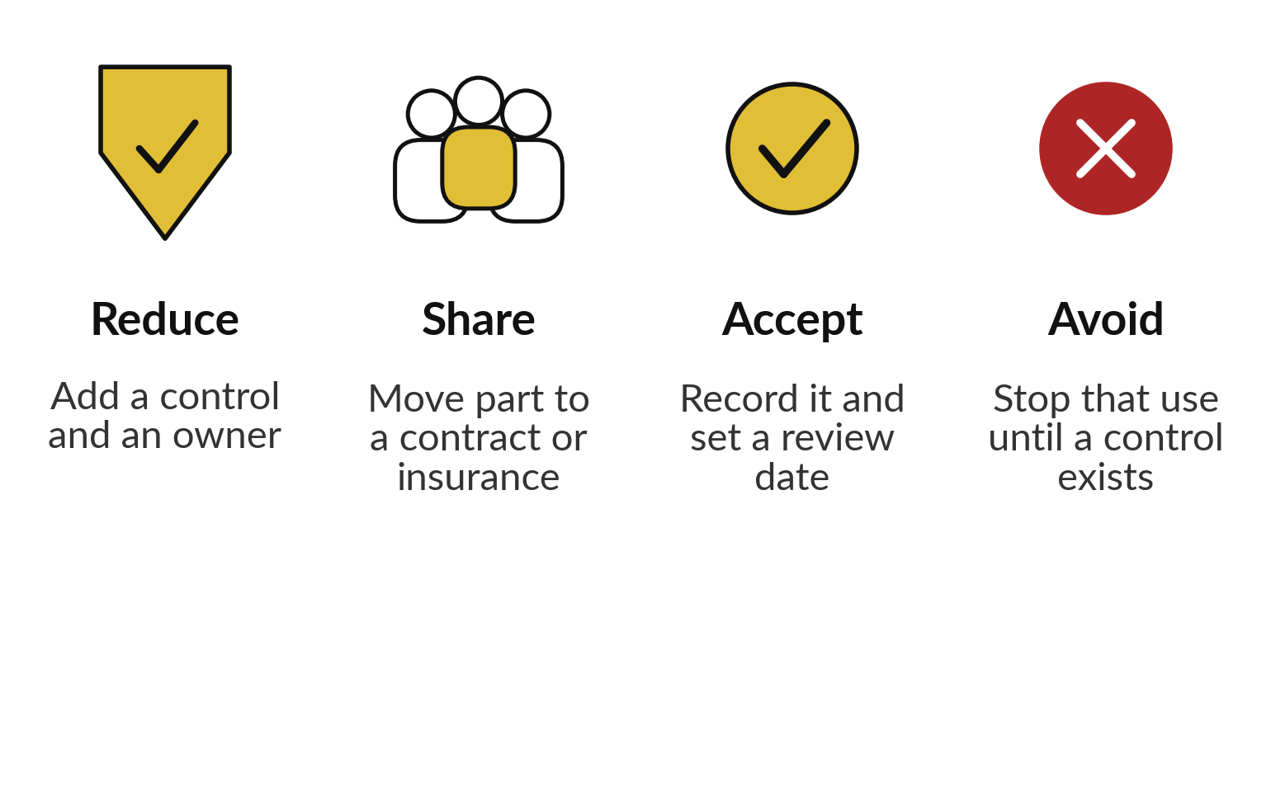
Four responses to a risk:
reduce, share, accept or avoid
Every scored risk gets one of these four.
Most risks end in reduce.
Low risks are often accepted.
A High risk you accept needs a reason you can defend.
Notes:
Once a risk has a score, you choose a response, and there are four. Reduce: add a control and a named owner. Most risks end here. Share: move part of the risk to a supplier contract or to insurance. Accept: record the risk, watch it and set a date to review it.
That suits a Low risk. Avoid: stop that use of AI until a control exists. If you accept a High risk, you need a reason you could defend to the owner of the business. Keep these four words, because you use them in your decision at the end of the session.

Slide 9
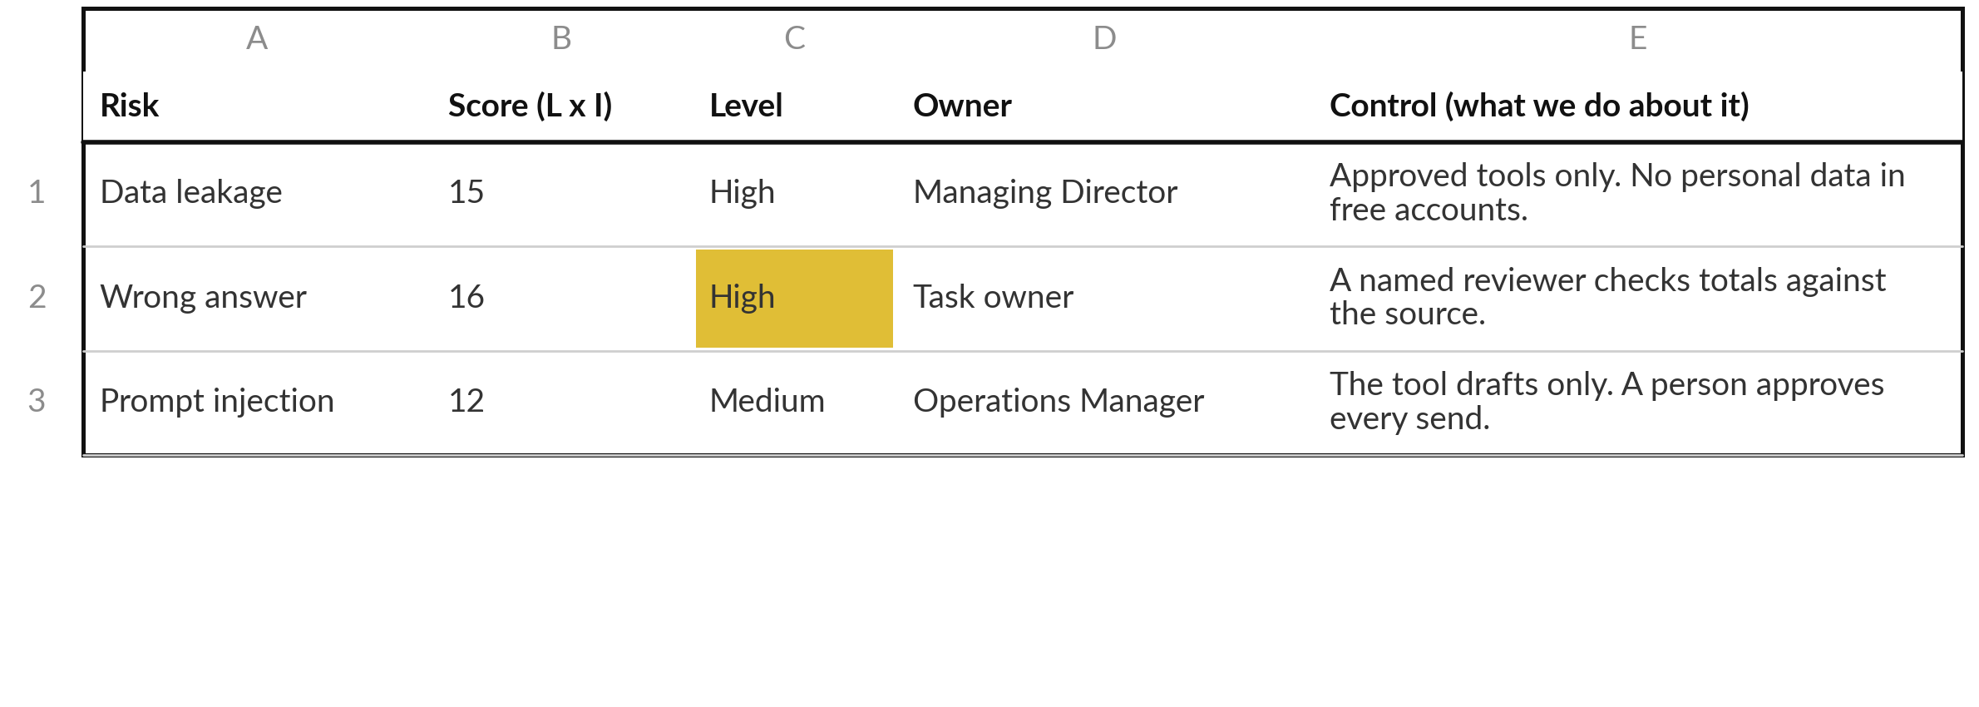
Three finished rows from a risk register
Typical rows from the Risk Register template, written for Nile Valley Foods. Scores are illustrative.
Notes:
Here are three finished rows for Nile Valley Foods, from the template. Data leakage: likelihood three, impact five, score fifteen, High. Wrong answer: four times four, sixteen, High. Prompt injection: three times four, twelve, Medium. Each row has one named owner and one real control, which is an action somebody actually does, such as a named reviewer who checks totals every week.
The scores are illustrative, and yours will differ. The register already holds eight typical rows, so you edit and delete rather than start from a blank page.

Slide 10





Six names you will hear, and what each is for
Name | What it is | What you do with it
NIST AI RMF | A voluntary US framework of four functions. | Use it as a checklist for your own work.
ISO/IEC 42001 | The AI management standard. Auditors can certify it. | Ask a vendor which standard it holds.
OECD AI Principles | Shared principles for trustworthy AI. | Use as a plain list of values.
African Union AI Strategy | A continental strategy for national plans. | Watch for national rules that follow it.
EU AI Act | A law. It applies only if you serve the EU. | Its staff-training duty is a model.
Uganda national AI strategy | A national plan. Its status can change. | Ask the facilitator for the current status.
Notes:
Six names you will hear. NIST is a voluntary framework from the United States with four functions: Govern, Map, Measure and Manage. Use it as a checklist. ISO forty-two thousand and one is the AI management standard, and an auditor can certify it. In my experience, most vendors hold SOC 2 or ISO 27001, which are security standards, so when a vendor says certified, ask which standard and ask to see the report.
The OECD principles are shared values. The African Union has a continental strategy. The EU AI Act applies only if you serve customers in the EU. The Uganda strategy can change, so I re-check it the week we meet.

Slide 11
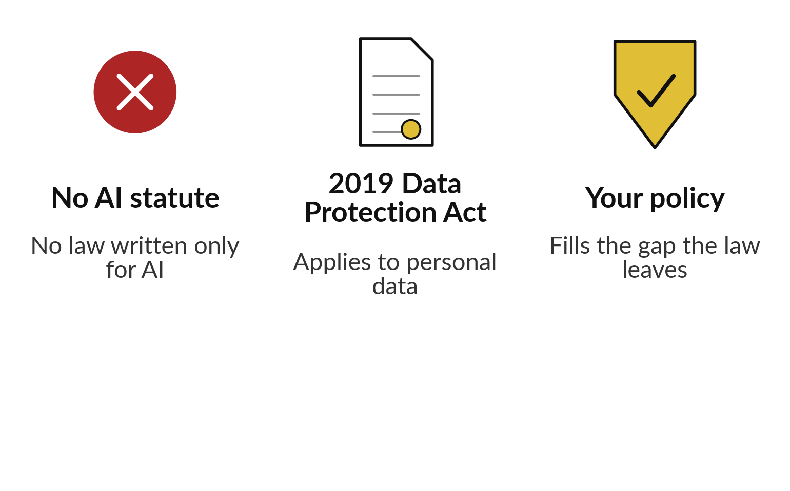
Uganda has no AI statute, and the
2019 Data Protection Act applies
The Data Protection and Privacy Act 2019 applies to personal data.
Check your duties, including whether and when to report a breach, with your lawyer or the Personal Data Protection Office.
Notes:
Uganda has no law written only for AI. That does not mean no rules. My understanding is that the Data Protection and Privacy Act 2019 applies to personal data, including when it is used with an AI tool. The three columns show the position: no AI statute, the 2019 Act, and your own policy filling the gap.
I am not a lawyer, and this is not legal advice. For your duties, such as registration, sending data abroad and reporting a breach, confirm with your lawyer or the Personal Data Protection Office. If you ask me, I will give you my understanding and send you to them.

Slide 12



Take five questions about
personal data to your lawyer
Which of our AI uses involve personal data?
What are our duties under the 2019 Act for each use?
Whether and when must we report a breach?
What must a vendor contract say about our data?
What must we tell staff and customers?
Notes:
Five questions to take to your lawyer or to the Personal Data Protection Office. I do not answer them for you, because the detail depends on your company and the law can change. Which of our AI uses involve personal data?
What are our duties under the 2019 Act for each use?
Whether and when must we report a breach?
What must a vendor contract say about our data?
And what must we tell staff and customers?
Until you have the answers, keep personal data such as CVs and customer lists out of free tools.

Slide 13


A ban can push AI use out
of sight, so write a policy
Ban only
Policy and approved tools
Staff may still use personal accounts.
You cannot see what data leaves.
Nobody is trained or checked.
Company accounts with a named owner.
Data rules by sensitivity.
Training and one place to report.
Shadow AI is staff using AI through personal accounts. A policy gives them a safe route.
Notes:
Many executives ask whether to ban AI. In my experience, and in what many companies report, a ban pushes use out of sight. People use personal accounts anyway, which is called shadow AI. Then you cannot see what data leaves, and nobody is trained. A policy gives staff a safe route: company accounts with a named owner, clear rules on what data may go in, training, and one place to report a problem.
Nile Valley Foods already has a handbook rule against pasting customer data into a public AI tool without written approval. A policy extends that rule and gives staff something they may use.

Slide 14
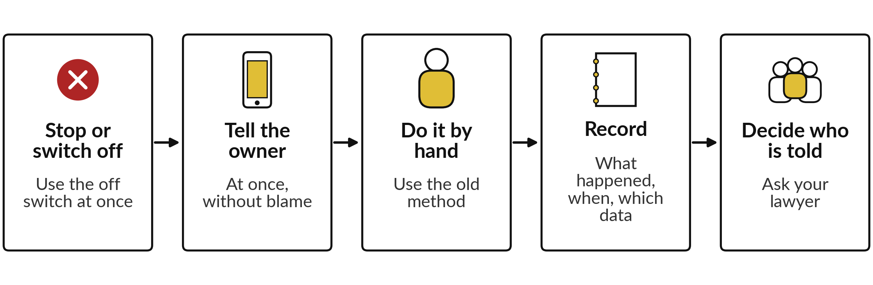
When something goes
wrong: five steps, then fix it
Then fix the cause, test again and update the policy. The NVF handbook asks for a suspected data loss to be reported within 4 hours.
Notes:
If something goes wrong, there are five steps and then the fix. Stop or switch off, using the off switch you built in Session 8. Tell the owner of the automation at once, and never blame someone for reporting in good faith. Do the task by hand with the old method, so the work still gets done.
Record what happened, when and which data was involved. Decide who must be told: customers, staff and, if personal data leaked, whether and when to report to the Personal Data Protection Office. Ask your lawyer or the Office, and do not guess. Then fix the cause, test again and update the policy.

Slide 15
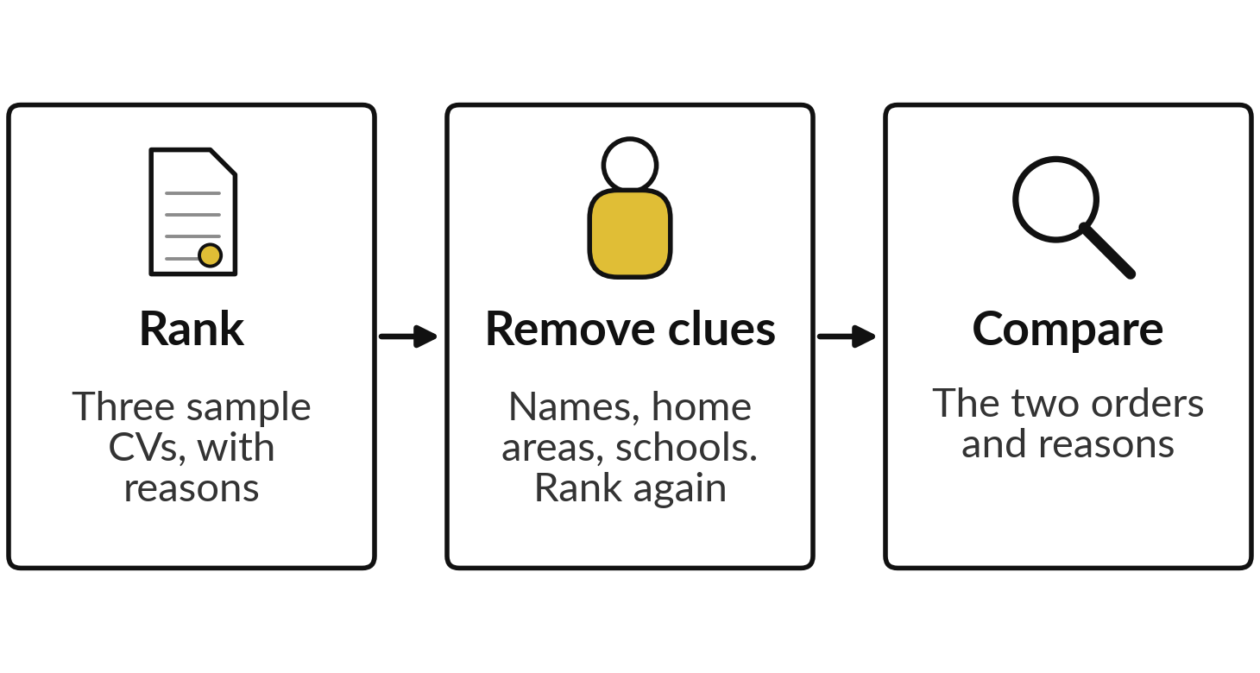
Demonstration: rank sample
CVs with and without names
I will show
Watch for
Does the order change?
Does any reason use something the job does not need?
Who answers for the result?
Notes:
Now a bias demonstration with synthetic CVs, so no real person is involved. The three steps on the left show the plan. I give an AI tool three sample CVs and the job description for a dispatch clerk and ask for a ranking with reasons. Then I remove names, home areas and school names and ask again.
I do not know in advance what the tool will say, so we check the live result together. Watch whether the order changes and whether a reason uses something the job does not need. Names can point to a region, a gender or a background, and a tool can repeat that without warning.

Slide 16
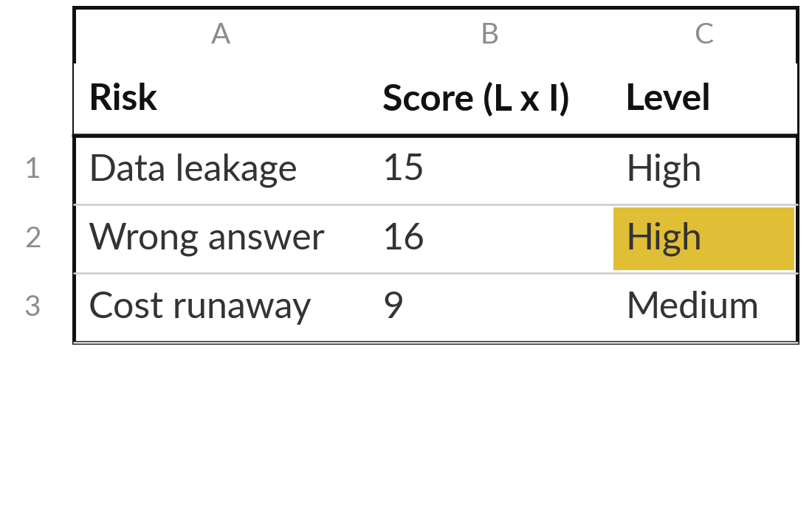
Practice: build the risk register for your own task
20 minutes
Your own company task
Score the risks of your own task and give each one an owner.
Start with your question from last time: who would be hurt first? Score that risk first.
Open the Risk Register. Edit the eight typical rows for your task.
Score likelihood and impact from 1 to 5. Read the level.
Name one owner and one real control for every row.
You keep: At least six scored risks, each with an owner and a control.
Notes:
Take twenty minutes. Start with your question from last time: if your automation made a mistake tomorrow, who would be hurt first?
Score that risk first. Then open the Risk Register. The eight grey rows are typical risks, so edit each one for your own task and delete those that do not apply. Add risks of your own, for example one from your test log in Session 8. Score likelihood and impact from the Scale sheet, and read the level it gives: High, Medium or Low.
Then name one owner and one real control for every row. A row without both is only a worry. I will check your High rows with you first.

Slide 17
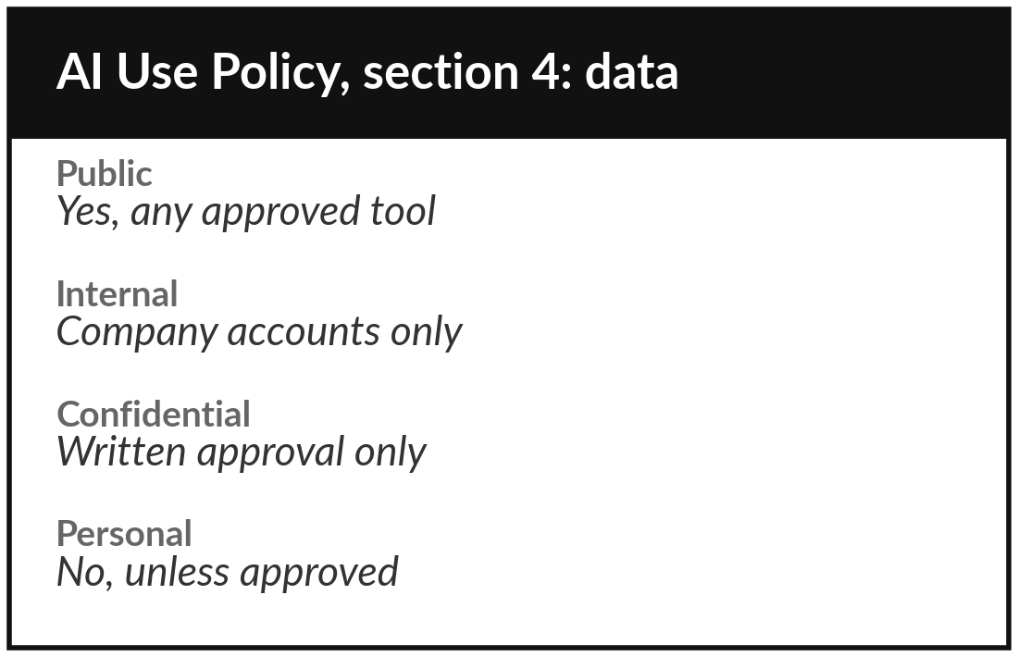
Practice: write the first draft
of your company AI-use policy
25 minutes
Your own company task
Fill in the main sections of the AI Use Policy Template.
Replace each square bracket with your own words.
List approved tools and the data allowed at each sensitivity level.
Name who reviews, who discloses, who handles incidents and training.
Mark what your lawyer must check.
You keep: A first draft policy you can share with colleagues and your lawyer.
Notes:
Twenty-five minutes for the policy. Open the template and replace every square bracket with your own words. If the time is short, do sections three, four and eight first: approved tools, the data table and incidents. Use your information inventory from Session 4 to decide what may go in at each sensitivity level.
For incidents, use the same steps we saw earlier, and ask your lawyer about who must be told. Then name who reviews what, how you disclose AI use, and how staff are trained. Keep the wording plain enough that every member of staff understands it in one reading. A draft is enough today.

Slide 18




Decision: what will you do about
each of your top three risks?
Which response fits each of your three highest-scoring risks?
Reduce
Share
Accept
Avoid
Add a control and a named owner.
Move part of it to a supplier contract or insurance.
Record it, watch it, and review on a set date.
Stop that use of AI until a control exists.
For each of your top three risks, write the response, the owner and a review date.
Notes:
Decide for your top three risks, using the four responses from earlier. Reduce, share, accept or avoid. Most risks end in reduce. For each one, say which response you can really carry out, and who will do it. A High risk that you accept needs a reason you could defend to the owner of the business.
Write the response, the owner and a review date for each of your three in the register. Bring the register to Session 10, because vendor terms often decide whether you can share a risk or must reduce it yourself.

Slide 19
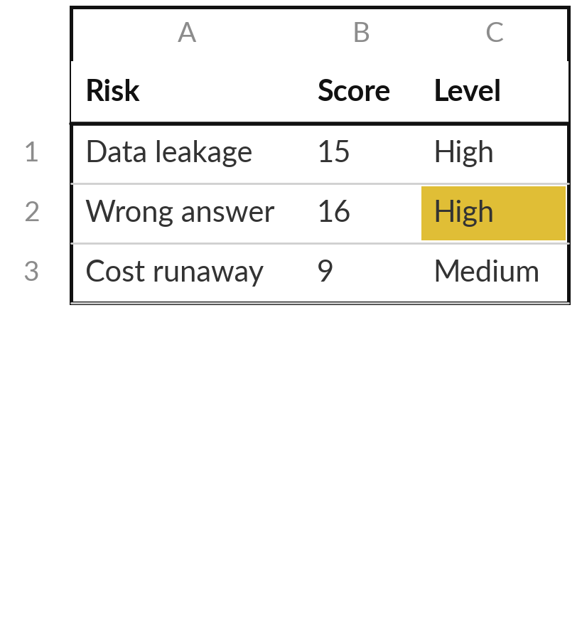
Save it, and bring one question to the next session
What you keep from today
Your Risk Register for the own task and the first draft of your company AI-use policy.
Our question today
What could go wrong, and what rules should my company set?
Next session
Session 10: Buying and oversight. You will read a vendor proposal and write the five questions you will ask your own vendor.
Notes:
Save the register and the policy draft together. Share the policy draft with the people it affects, and ask your lawyer to check it before the owner of the business signs it. Optional, if you want a head start on Session 10: think of one AI product that someone has pitched to you, and ask yourself what you would need to know before saying yes. We read a vendor proposal next time.
We began with this question: What could go wrong, and what rules should my company set? Before you go, say in one sentence what you can now say about it.

